Slide 1
WHAT IS HIERARCHICAL CLUSTERING
Hierarchical clustering is a popular method for grouping objects.
It creates groups so that objects within a group are similar to each other and different from objects in other groups.
Clusters are visually represented in a hierarchical tree called a dendrogram.
Hierarchical clustering is the most popular and widely used method to analyze social network data.
In this method, nodes are compared with one another based on their similarity.
Larger groups are built by joining groups of nodes based on their similarity.

Slide 2
Hierarchical Clustering
A Hierarchical clustering method works via grouping data into a tree of clusters. Hierarchical clustering begins by treating every data point as a separate cluster. Then, it repeatedly executes the subsequent steps:
Identify the 2 clusters which can be closest together, and
Merge the 2 maximum comparable clusters. We need to continue these steps until all the clusters are merged together.
In Hierarchical Clustering, the aim is to produce a hierarchical series of nested clusters.
A Dendrogram is a tree-like diagram that statistics the sequences of merges or splits.

Slide 3
The hierarchical clustering technique has two approaches:
Agglomerative: Agglomerative is a bottom-up approach, in which the algorithm starts with taking all data points as single clusters and merging them until one cluster is left.
Divisive: Divisive algorithm is the reverse of the agglomerative algorithm as it is a top-down approach.

Slide 4
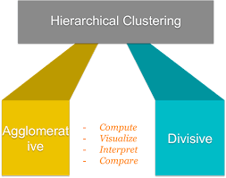
Types of Hierarchical Clustering

Slide 5
AGGLOMERATIVE CLUSTERING
Agglomerative clustering is one of the most common types of hierarchical clustering used to group similar objects in clusters.
Agglomerative clustering is also known as AGNES (Agglomerative Nesting). In agglomerative clustering, each data point act as an individual cluster and at each step, data objects are grouped in a bottom-up method.
Initially, each data object is in its cluster. At each iteration, the clusters are combined with different clusters until one cluster is formed.

Slide 6
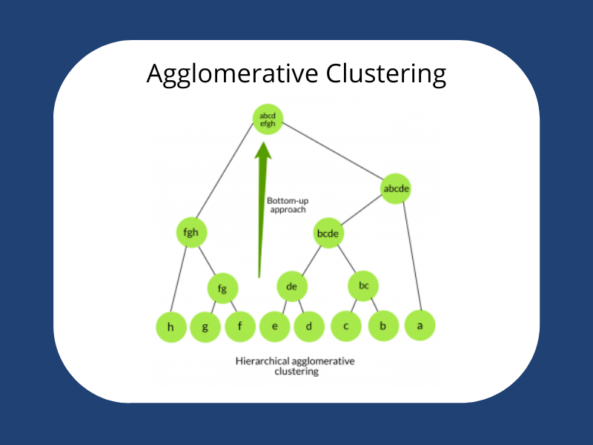
AGGLOMERATIVE CLUSTERING

Slide 7
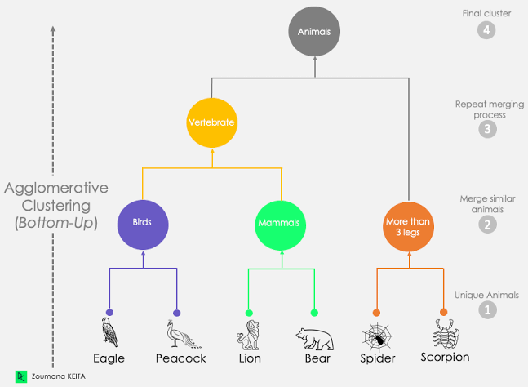
AGGLOMERATIVE CLUSTERING

Slide 8
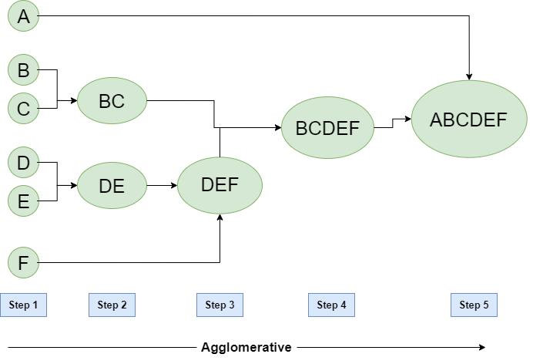
AGGLOMERATIVE CLUSTERING

Slide 9
AGGLOMERATIVE CLUSTERING
The algorithm for Agglomerative Hierarchical Clustering is:
Calculate the similarity of one cluster with all the other clusters (calculate proximity matrix)
Consider every data point as an individual cluster
Merge the clusters which are highly similar or close to each other.
Recalculate the proximity matrix for each cluster
Repeat Steps 3 and 4 until only a single cluster remains.

Slide 10
Divisive Hierarchical Clustering
Divisive hierarchical clustering is exactly the opposite of Agglomerative Hierarchical clustering.
In Divisive Hierarchical clustering, all the data points are considered an individual cluster, and in every iteration, the data points that are not similar are separated from the cluster.
The separated data points are treated as an individual cluster. Finally, we are left with N clusters.

Slide 11
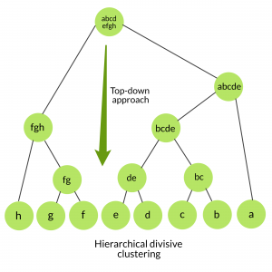
Divisive Hierarchical Clustering

Slide 12
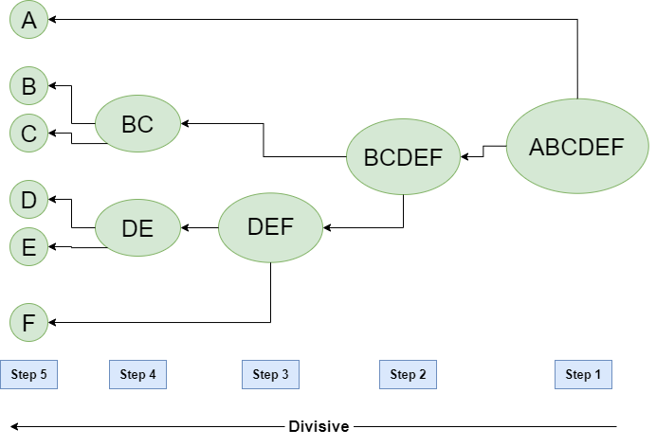
DIVISIVE CLUSTERING

Slide 13
DIVISIVE CLUSTERING
This approach starts with all of the objects in the same cluster.
In the continuous iteration, a cluster is split up into smaller clusters.
It is down until each object in one cluster or the termination condition holds.
This method is rigid, i.e., once a merging or splitting is done, it can never be undone.

Slide 14
APPLICATIONS
Clustering analysis is broadly used in many applications such as market research, pattern recognition, data analysis, and image processing.
Clustering can also help marketers discover distinct groups in their customer base.
And they can characterize their customer groups based on the purchasing patterns.
We don't have to pre-specify any particular number of clusters. ...
Easy to decide the number of clusters by merely looking at the Dendrogram.

Slide 15
Conclusion
Hierarchical clustering is a popular method for grouping objects.
It creates groups so that objects within a group are similar to each other and different from objects in other groups.
Types of Hierarchical Clustering
Agglomerative clustering is one of the most common types of hierarchical clustering used to group similar objects in clusters.
In Divisive Hierarchical clustering, all the data points are considered an individual cluster, and in every iteration, the data points that are not similar are separated from the cluster.

